Slide 1




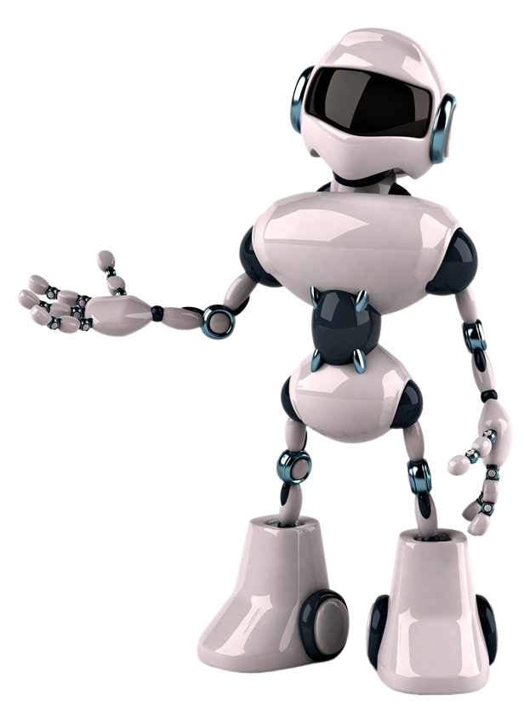





What is
Machine Learning
Session-1
Hussein Saleh Mohsen
Sara Zuhair Al talib
Mohammed Abdullah Safhi
Osama Alyami
7:00 – 9:00 PM

Slide 2



Agenda
01
What is Machine Learning?
02
Machine Learning Applications
03
Types of Machine Learning
04
ML Algorithm: Decision Tree (DT)

Slide 3

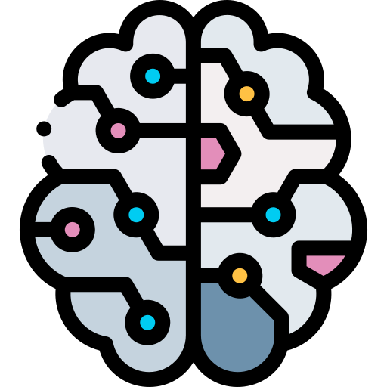


What is Machine Learning ?
Machine learning is a branch of artificial intelligence that involves algorithms learning from data to automatically predict and make decisions by themselves without human intervention.
It describes how computers perform tasks on their own by previous experiences.
Therefore, we can say Machine learning learns from experience.

Slide 4

Importance of machine learning
Providing a larger amount of data necessary for decision-making.
The ability to store data as much as possible.
Computer data processing is less expensive than hiring human hands.
Ensure obtaining more accurate results and decisions in the fastest time.

Slide 5
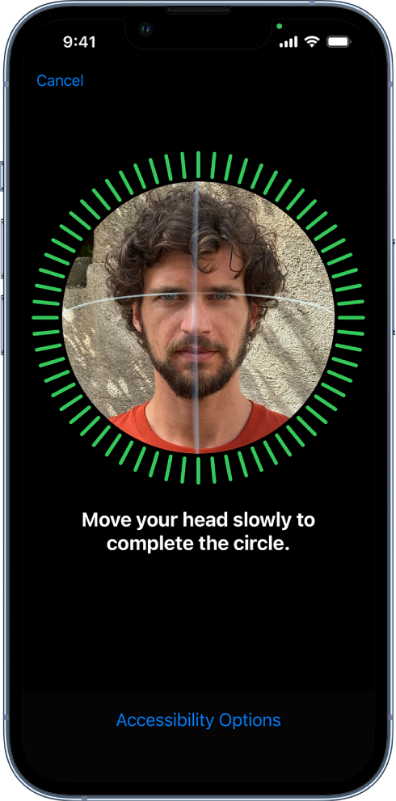
Machine learning applications
01
Image recognition
Have you ever unlocked your phone just by looking at it? If the answer is: yes; This is because of the most popular machine learning applications that work based on face detection and recognition algorithms.

Slide 6

Machine learning applications
02
Speech recognition
Some of the most well-known examples are Siri, Alexa, Cortona, and others. You can ask questions, such as: “What is the weather? or “What’re my alarms for today?” and other questions. The assistants will then search for information from sources to gather all the information needed and answer questions.

Slide 7
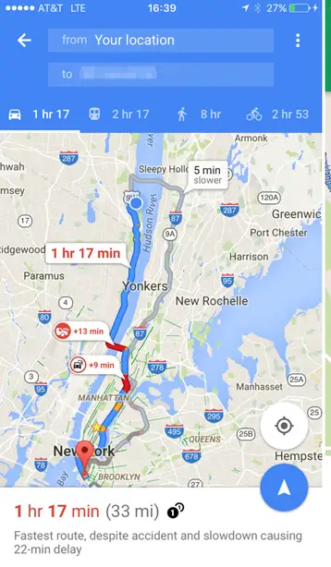
Machine learning applications
03
Traffic forecasts
When we use the GPS, the application automatically shows the different ways to travel, and we can also monitor traffic congestion by analyzing the daily passenger movement using machine learning.

Slide 8

Machine learning applications
04
Customer support
Nowadays, companies or websites provide the option to speak to a company's customer support representative, and instead of humans, chatbots often answer multiple inquiries posted by customers. The chatbot is one of the best Machine Learning applications.

Slide 9



Any questions?
let’s take a
5 minutes break

Slide 10
Types of machine learning
There are four types of Machine Learning:
01
Supervised
03
Semi-supervised
02
Unsupervised
04
Reinforcement

Slide 11


Supervised Learning
Supervised learning is an approach to creating artificial intelligence (AI), where a computer algorithm is trained on input data that has been labelled for a particular output.
The model is trained until it can detect the underlying patterns and relationships between the input data and the output labels, enabling it to yield accurate labeling results when presented with never-before-seen data.
Supervised learning can be separated into two types of problems :
Classification
Regression

Slide 12
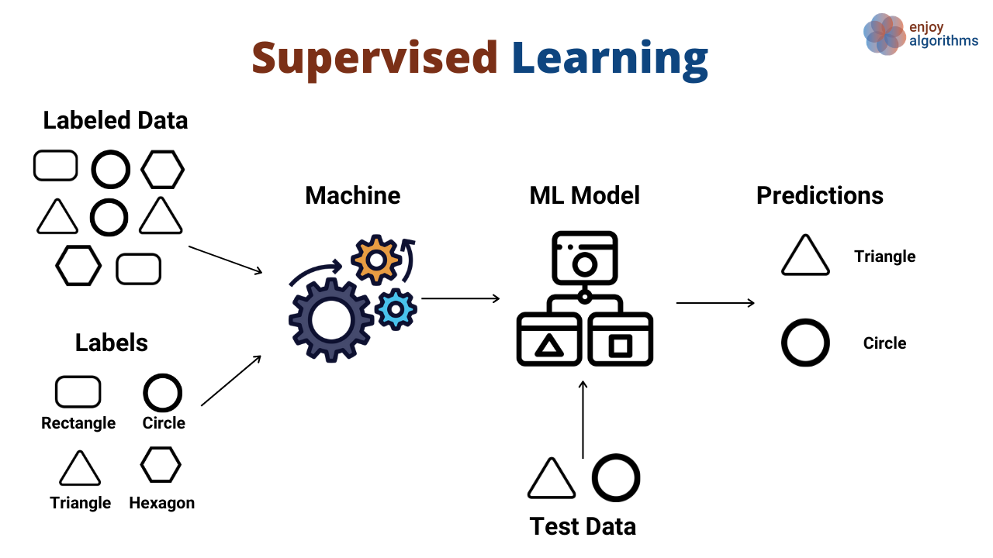

Supervised Learning
Suppose we have a dataset of different types of shapes which includes square, rectangle, triangle, and Polygon.
We need to train the model for each shape.
after training, we test our model using the test set, and the task of the model is to identify the shape.
Notes:
If the given shape has four sides, and all the sides are equal, then it will be labelled as a Square.
If the given shape has three sides, then it will be labelled as a triangle.
If the given shape has six equal sides then it will be labelled as hexagon.
If the given shape has no sides then it will be labelled as circle.
The machine is already trained on all types of shapes, and when it finds a new shape, it classifies the shape on the bases of a number of sides, and predicts the output

Slide 13




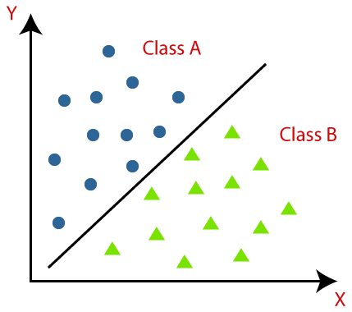

Classification Algorithms
Is used to identify the category of new observations on the basis of training data.
Example
The output variable of classification is a category.
filtering email into spam or non-spam.
filtering email into spam or non-spam.
categorizing customer feedback as positive or negative.
categorizing customer feedback as positive or negative.
identification of cancer cells.

Slide 14
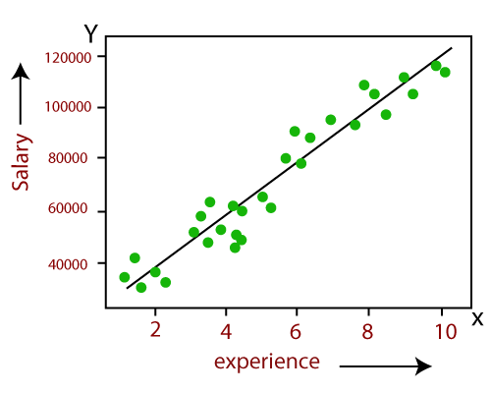
Regression Algorithms
Regression in machine learning consists of mathematical methods that allow data scientists to predict a continuous outcome (y) based on the value of one or more predictor variables (x).
Example
weather forecasting.
Market trends.
House price prediction.

Slide 15
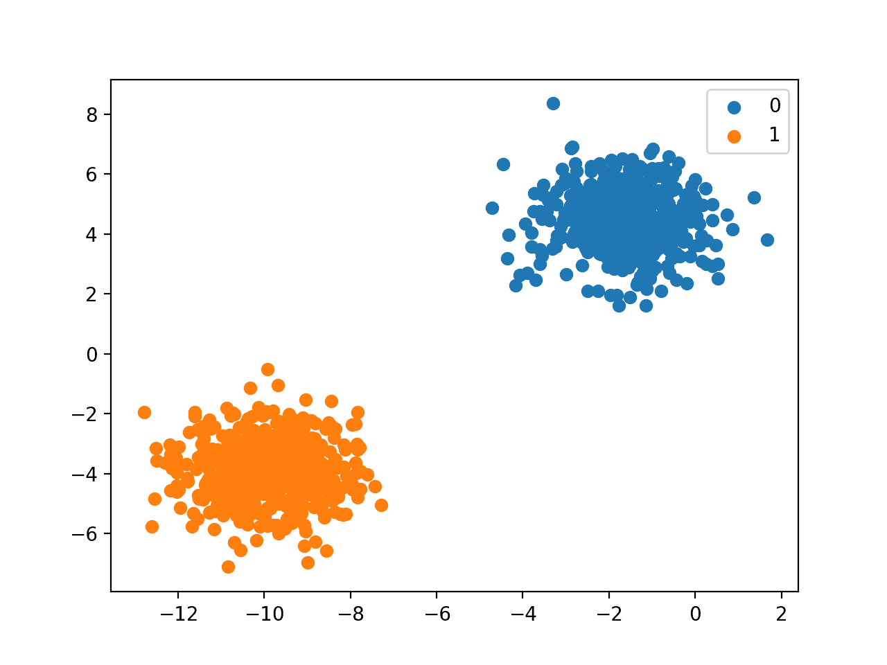
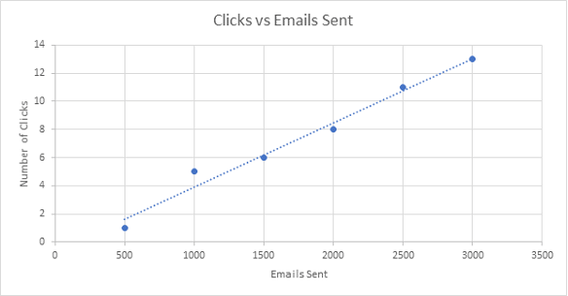
Challenge!

Slide 16
Unsupervised Learning
As the name suggests, unsupervised learning is a machine learning technique in which models are not supervised using a training dataset. Instead, the models themselves find hidden patterns and insights from the given data. It can be compared to learning which takes place in the human brain while learning new things.
The goal is to find the underlying structure of the dataset, group that data according to similarities, and represent that dataset in a compressed format.
Notes:
In the beginning : In the previous topic, we learned supervised machine learning in which models are trained using labelled data. But there may be many cases in which we do not have labelled data and need to find the hidden patterns from the given dataset. So, to solve such types of cases in machine learning, we need unsupervised learning techniques.
After first paragraph : can be compared to learning which takes place in the human brain while learning new things.

Slide 17
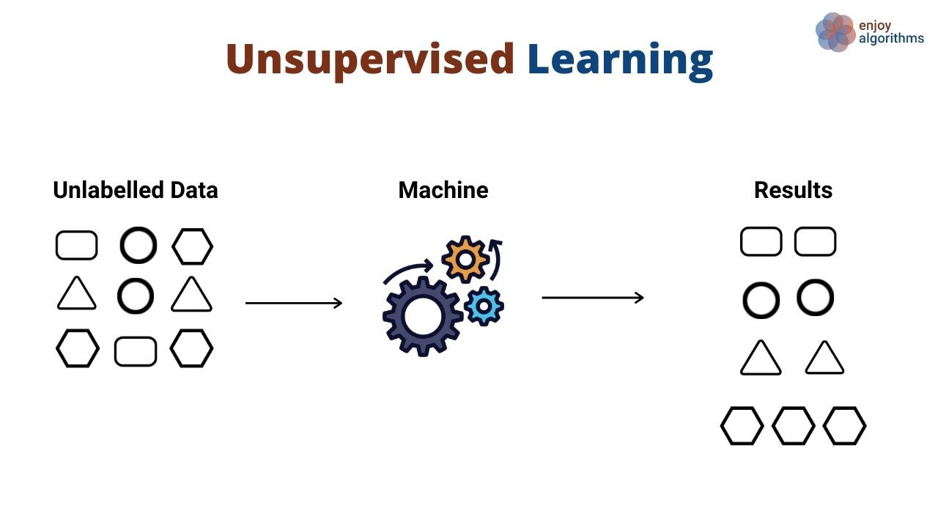
Unsupervised Learning
Here, we have taken unlabelled input data, which means it is not categorized and corresponding outputs are also not given.
Now, this data is fed to the machine learning algorithm to train it.
Firstly, it will interpret the raw data to find the hidden patterns in the data based on the technique, such as:
Clustering
Association
Anomaly detection
Therefore, unsupervised could be used as a pre-processing step before using supervised learning.
Notes:
Unsupervised learning is classified into two categories of algorithms:
Clustering
Association

Slide 18
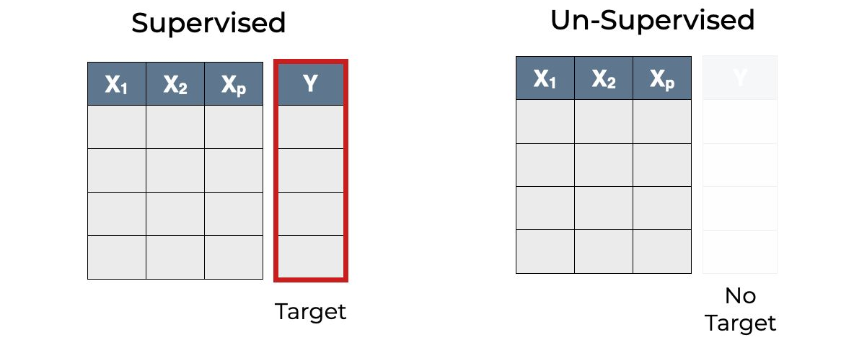
Supervised Vs. Unsupervised

Slide 19

Semi-supervised Learning
In a nutshell, semi-supervised learning is a machine learning technique that uses a small portion of labelled data and lots of unlabelled data to train a predictive model.
As a rule of thumb, a data set with at least 25% labelled data is suitable for semi-supervised learning. For instance, facial recognition.
Practical applications of Semi-Supervised Learning :
Speech Analysis
Internet Content Classification
Notes:
In the beginning : In cases where supervised learning is needed but there is a lack of quality data, semi-supervised learning may be the appropriate learning method. This learning model resides between supervised learning and unsupervised

Slide 20
Reinforcement Learning
Reinforcement Learning is a feedback-based Machine learning technique in which an agent learns to behave in an environment by performing the actions and seeing the results of actions. For each good action, the agent gets positive feedback, and for each bad action, the agent gets negative feedback or penalty.
Notes:
the agent learns automatically using feedbacks without any labelled data, unlike supervised learning. Here we do not need to pre-program the agent, as it learns from its own experience without any human intervention.

Slide 21
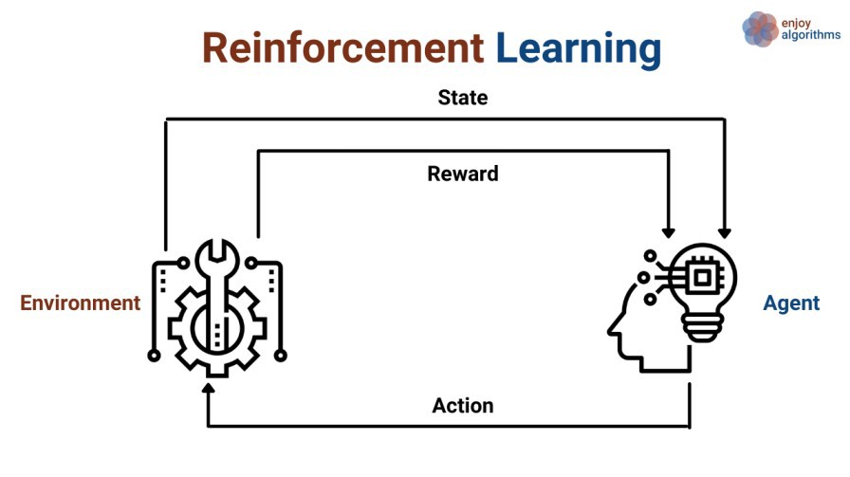
Reinforcement Learning
An agent acts on its environment, it receives some evaluation of its action, but it is not told which action is the correct one to achieve its goal.
Thus, the agent learns to perform the “actions” that maximize the rewards and minimize the punishments.
An environment is considered solved if the agent rewards reach the predefined threshold.

Slide 22



Reinforcement Learning
The goal of the robot is to get the reward that is the diamond and avoid the hurdles that are fired.
Notes:
The above image shows the robot, diamond, and fire. The goal of the robot is to get the reward that is the diamond and avoid the hurdles that are fired. The robot learns by trying all the possible paths and then choosing the path which gives him the reward with the least hurdles. Each right step will give the robot a reward and each wrong step will subtract the reward of the robot. The total reward will be calculated when it reaches the final reward that is the diamond.

Slide 23

Reinforcement Learning
Positive
Negative
Think of it as adding something in order to increase a response.
Taking something negative away in order to increase a response
Punishment
Extinction
Adding something aversive in order to decrease a behaviour.
When you remove something in order to decrease a behavior.

Slide 24
Any questions?
let’s take a
5 minutes break

Slide 25
Decision Tree
is one of the most powerful and popular tools for classification and prediction.
A Decision tree is a flowchart-like tree structure where each internal node donates a test on an attribute, each branch represents an outcome of the test, and each leaf node(terminal node)holds a class label.
Types
When a decision Tree classifies things into categories it’s called Classification Tree
When decision Tree predicts numeric values
It called a Regression Tree

Slide 26


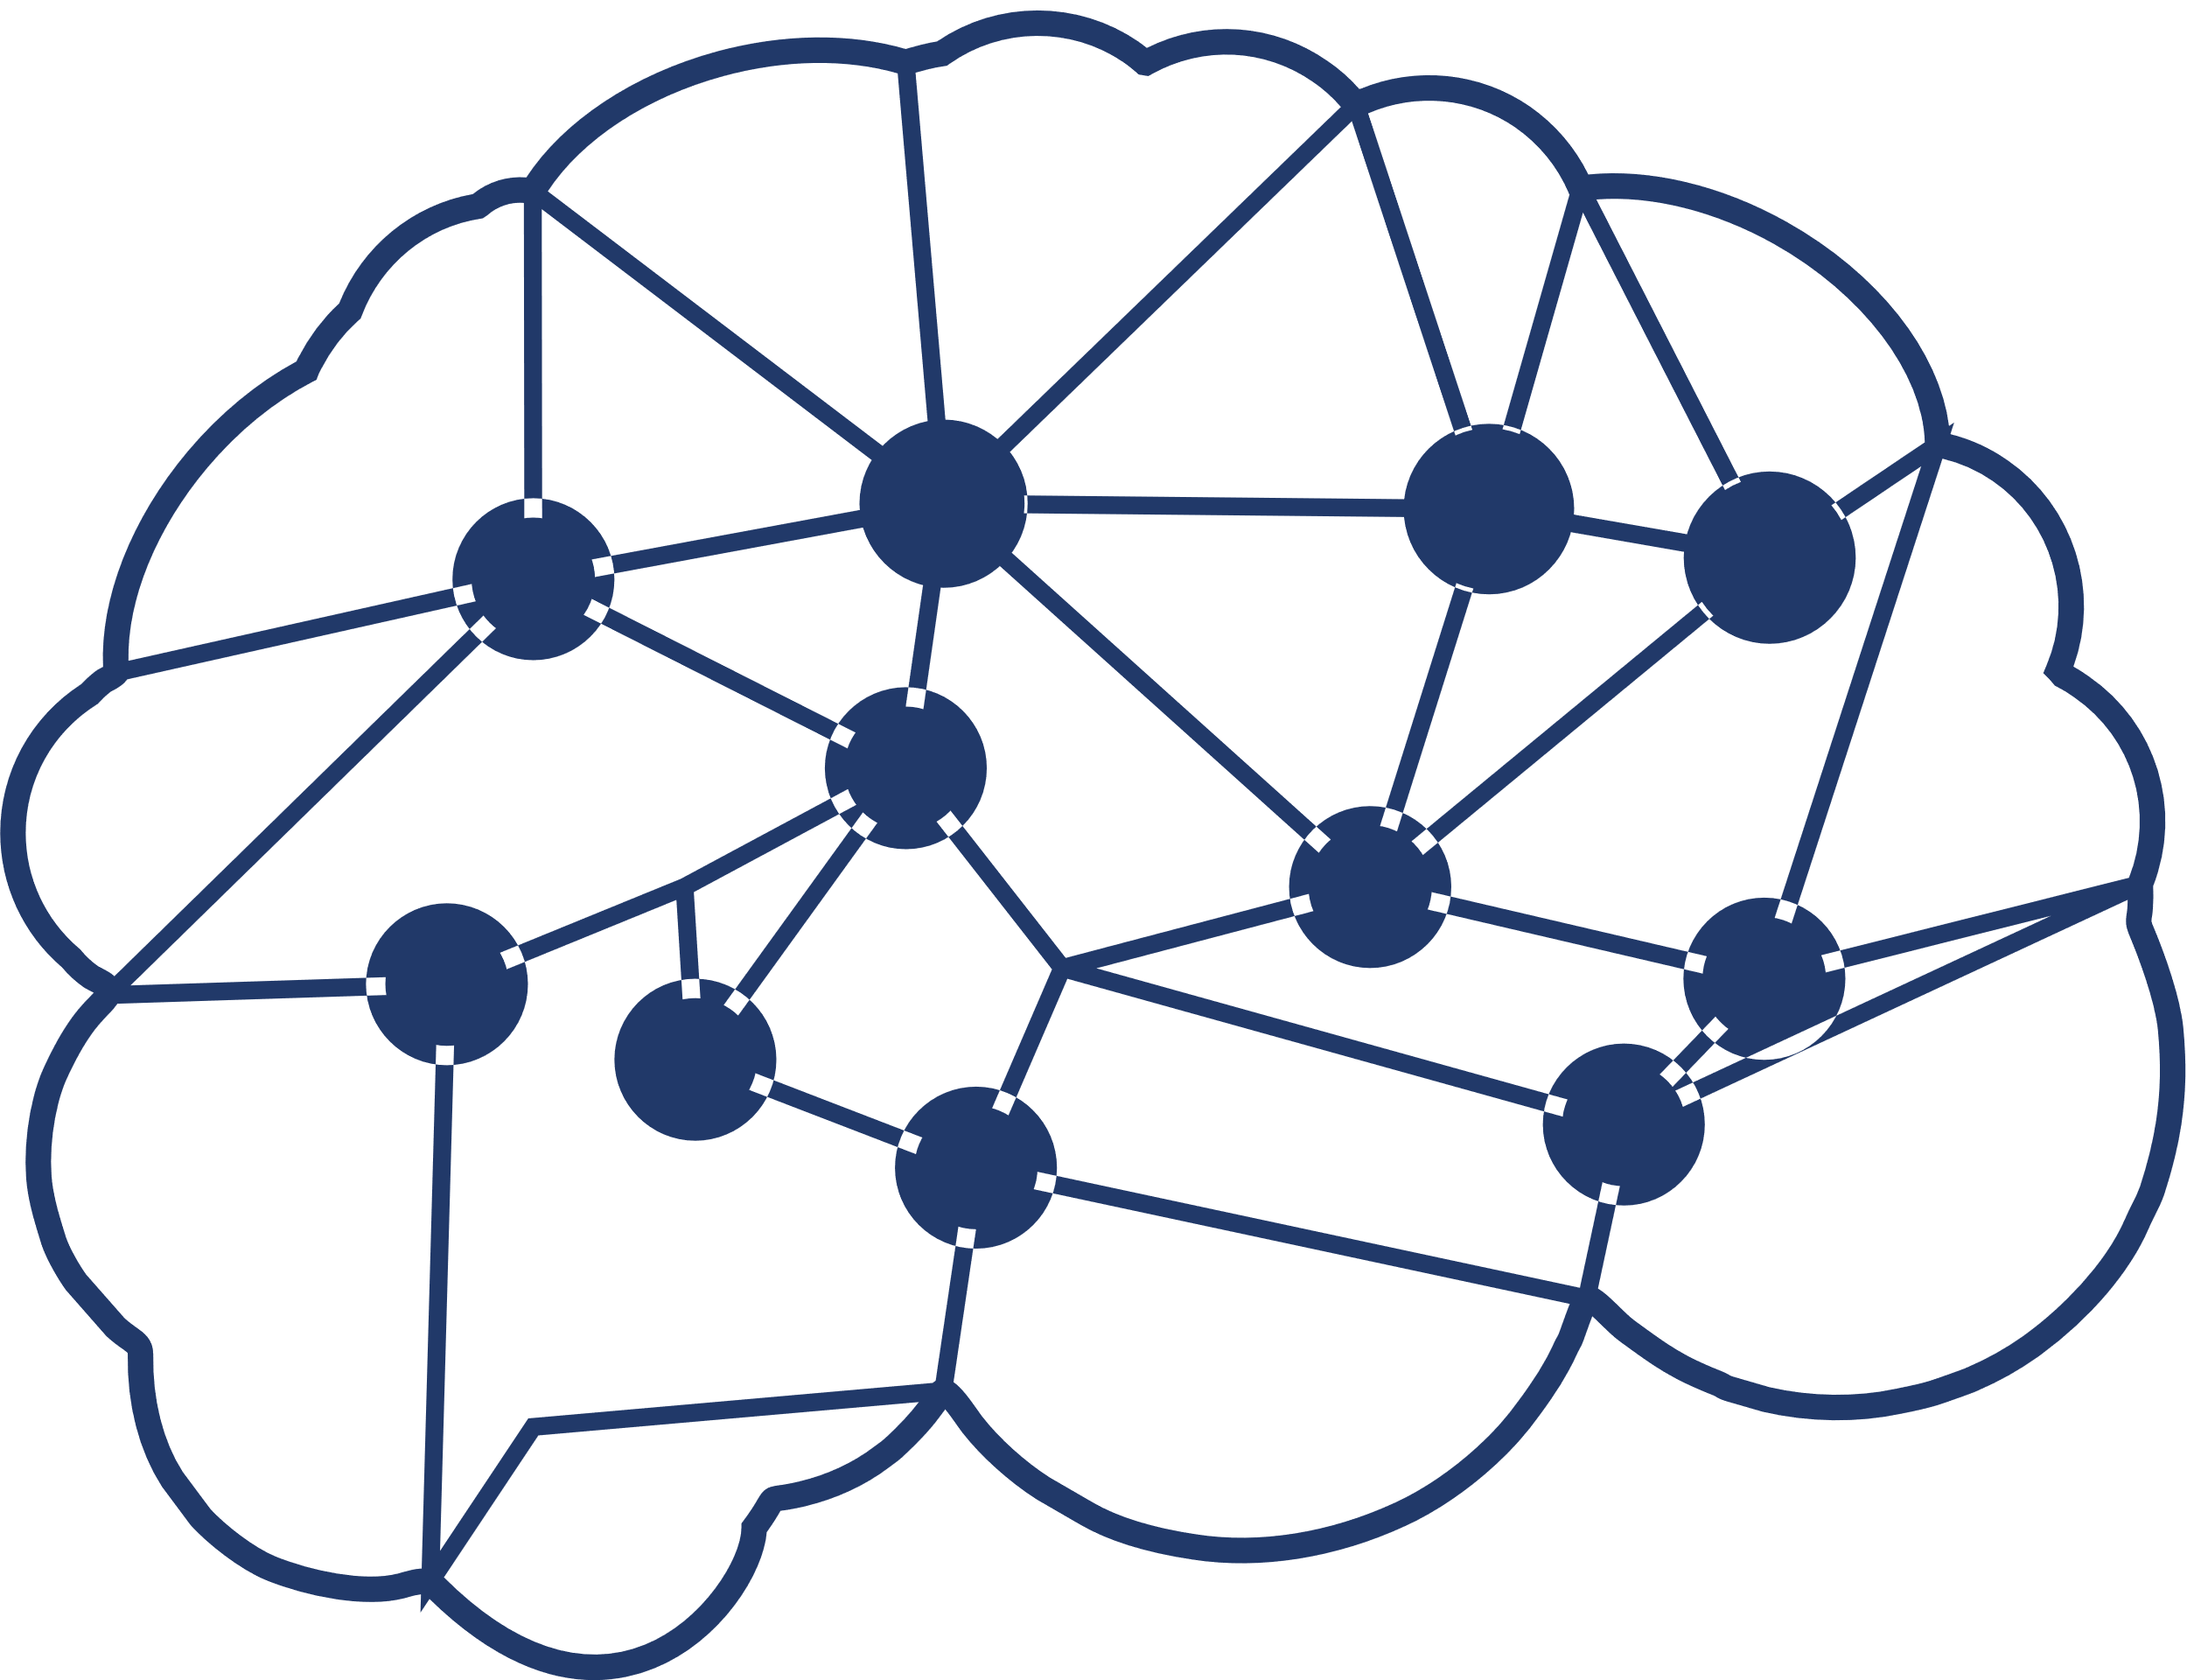
What is Decision Tree ?
Decision tree builds classification or regression models in the form of a tree structure.
A decision tree is a graphical representation of possible solutions to a decision based on certain conditions.
It is called a decision tree because it starts with a single variable, which then branches off into a number of solutions, just like a tree.

Slide 27
Components of Decision Trees
A decision tree has three main components :
Root Node: The topmost node is called Root Node. It implies the best predictor (independent variable).
Decision / Internal Node: The nodes in which predictors (independent variables) are tested and each branch represents an outcome of the test.
Leaf / Terminal Node: It holds a class label (category) - Yes or No (Final Classification Outcome).

Slide 28
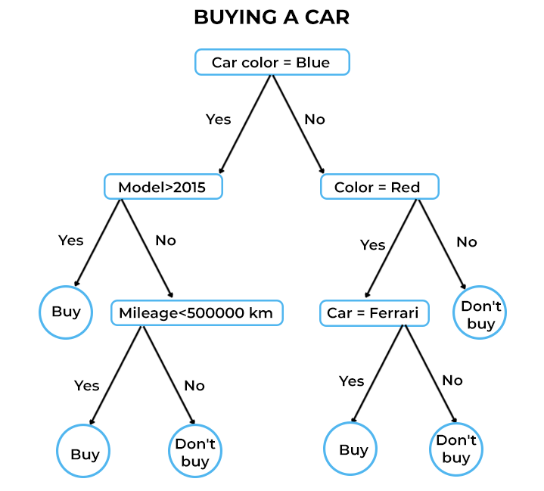
How does it work ?
Step 01: Pick the variable that gives the best split.
Step 02: Partition the data based on the value of this variable.
Step 03: Repeat step 1 and step 2.

Slide 29
Pros of Decision Tree
Decision trees are easy to understand and map nicely to a set of production rules and they have been successfully applied to real problems.
Decision trees make no prior assumptions about the nature of the data, and they are useful in data exploration.
Decision trees can build models with datasets containing numerical as well as categorical data. And they can perform feature selection which is very important in predictive analytics.
Decision trees help save data preparation time, as they are not sensitive to missing values and outliers.

Slide 30
Cons of Decision Tree
Decision Trees do not fit well for continuous variables and result in instability.
Decision trees are easy to use when compared to other decision-making models but creating large decision trees that contain several branches is a complex and time-consuming task.
The Decision tree get unstable due to the variation in the data.

Slide 31


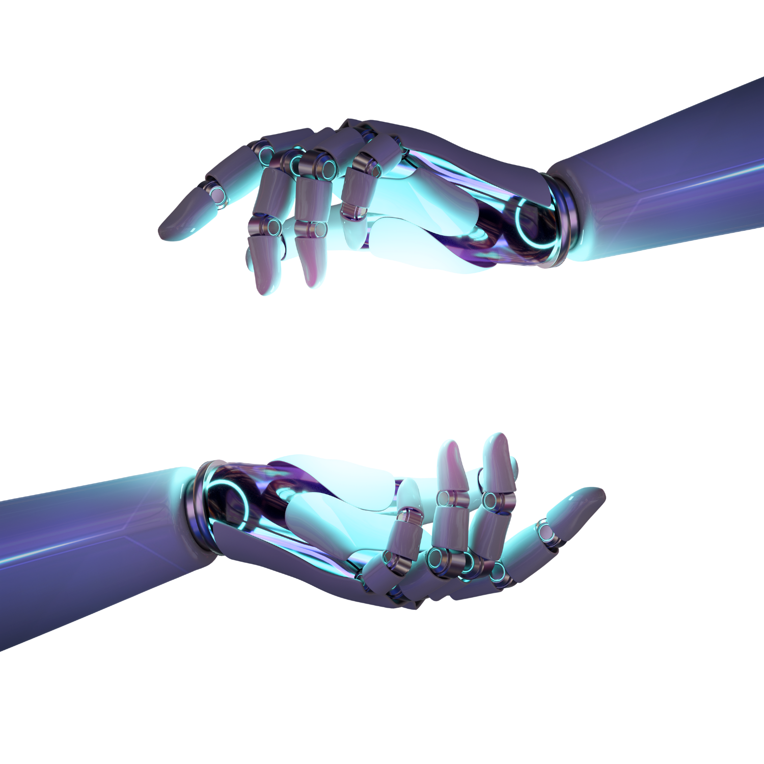

Thank You

